Slide 1
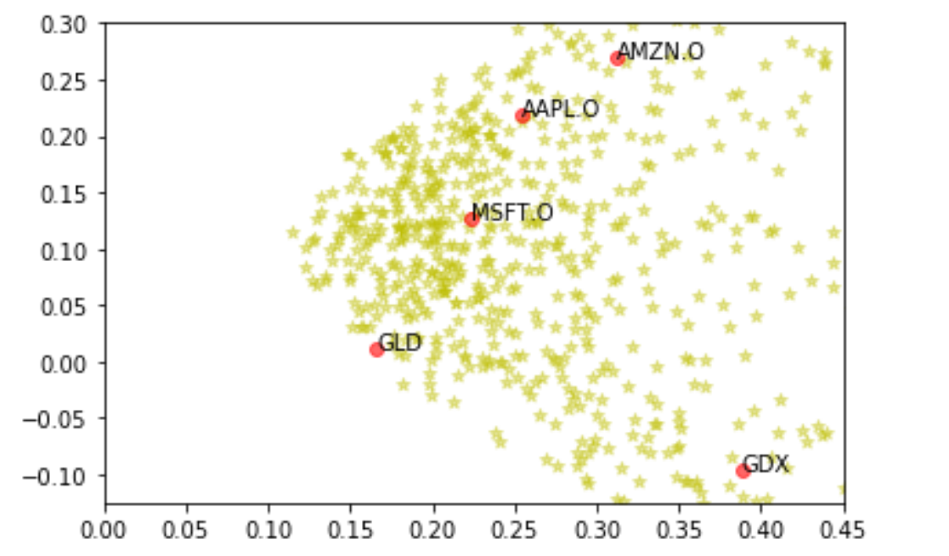
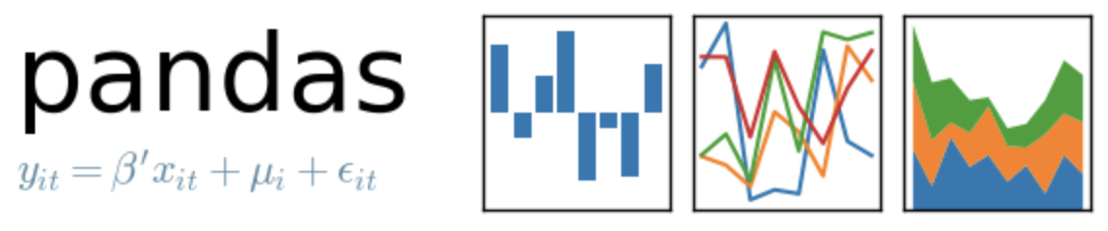
Portfolio Optimization
-
Random Portfolio

Slide 2
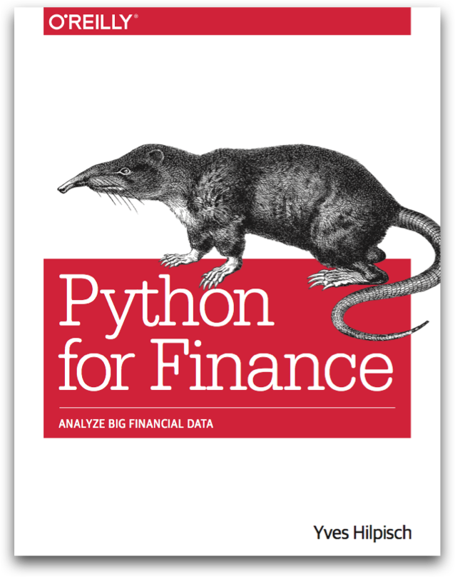
Reference
Chapter 11 of Python for Finance (O'Reilly)
Data
Youtube
Code

Slide 3
Data Loading

Slide 4
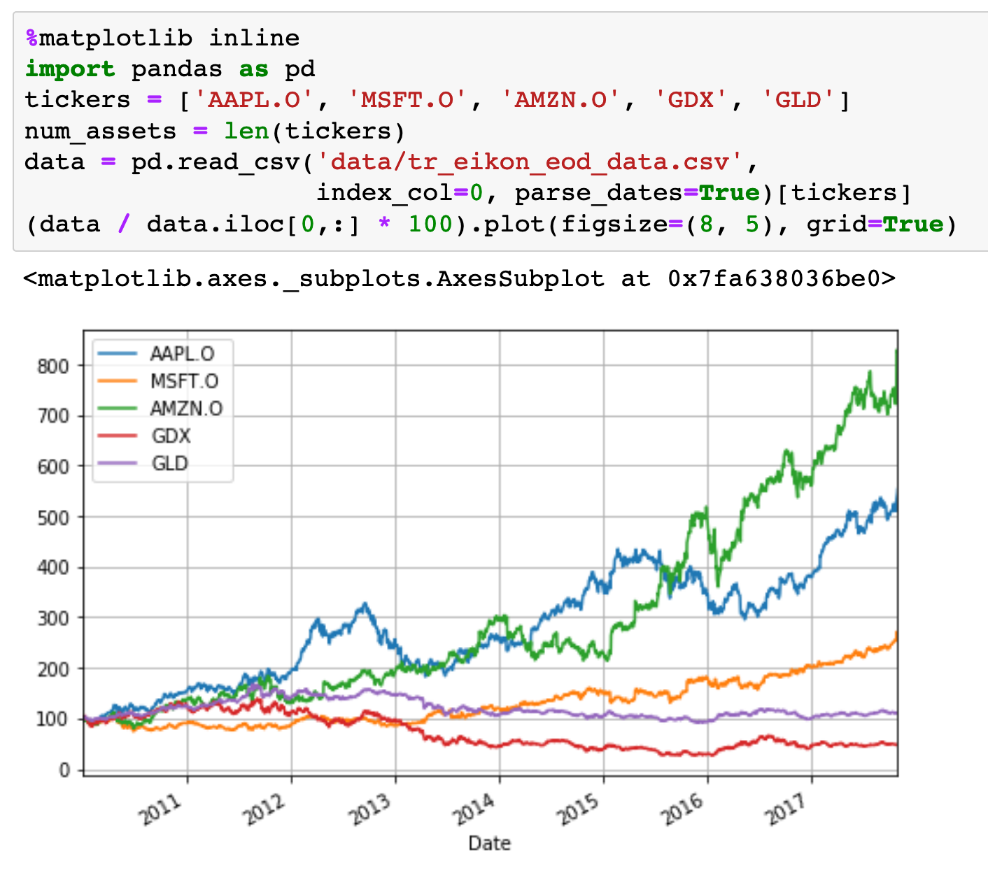

Slide 5
Computation
of
Mu and Sigma

Slide 6
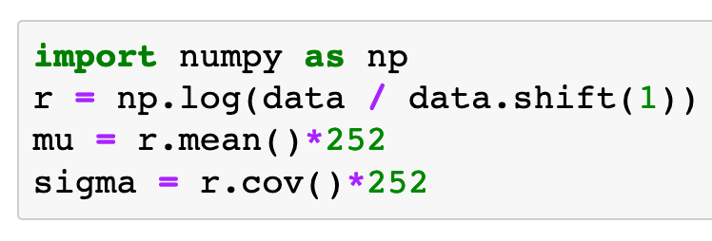
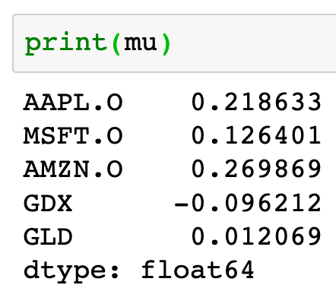
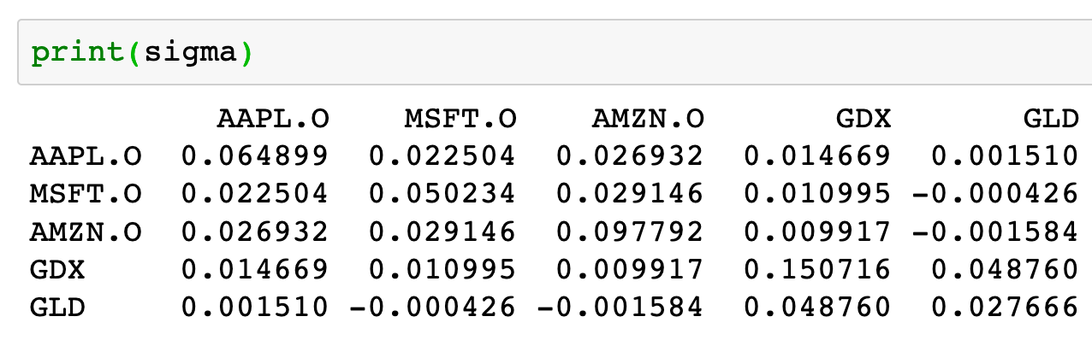

Slide 7
Risk-Return Plot

Slide 8
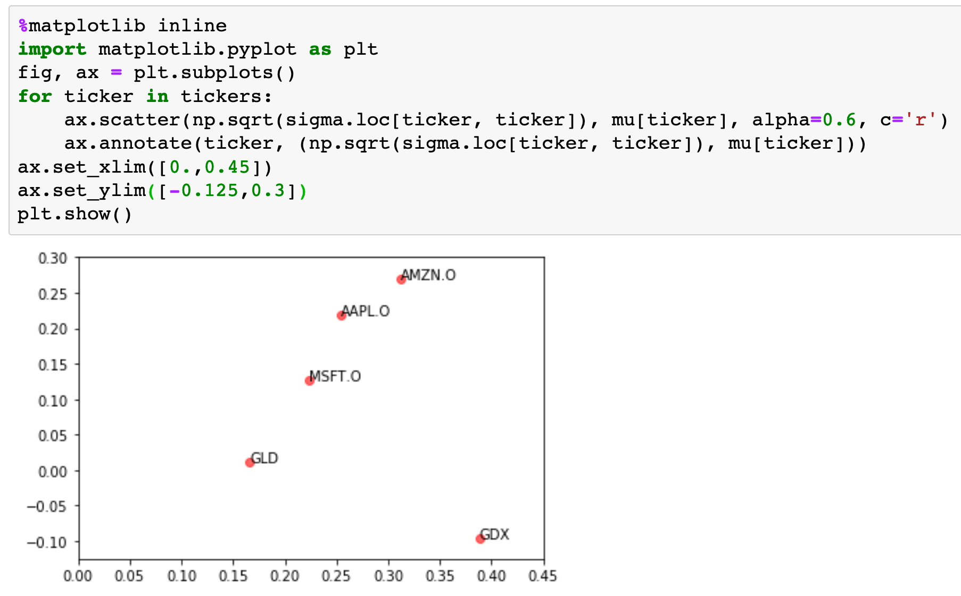

Slide 9
Copy
Original
Tickers, Mu and Sigma

Slide 10
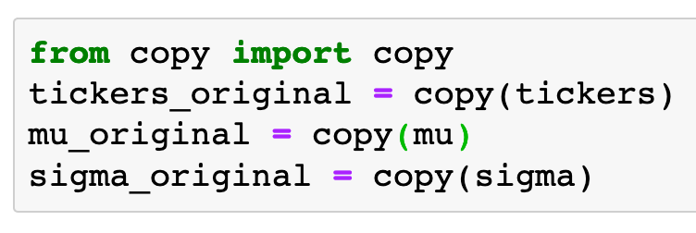

Slide 11
Computation
of
Portfolio’s Mu and Sigma

Slide 12
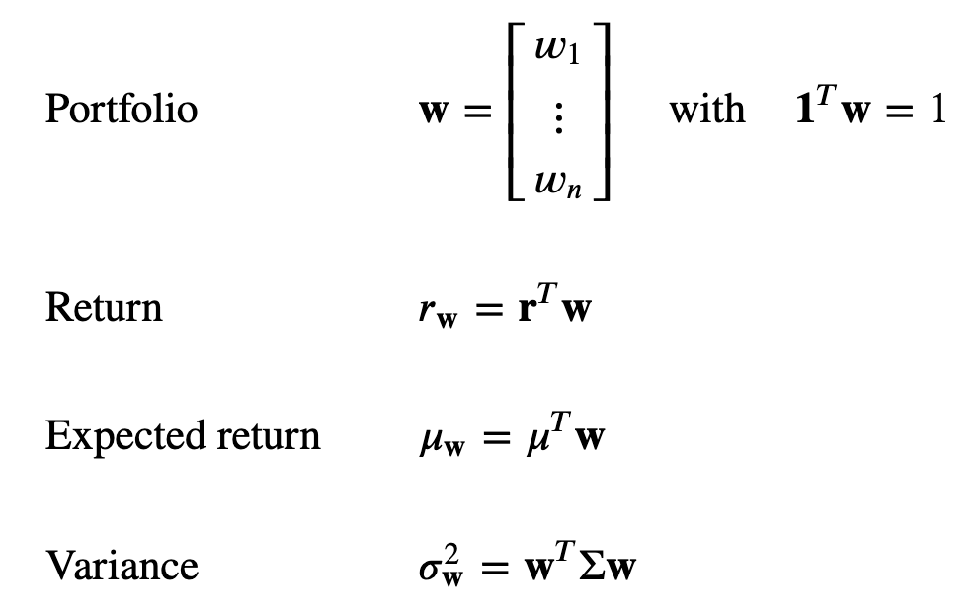

Slide 13
Random Portfolios
(No Short Positions)

Slide 14
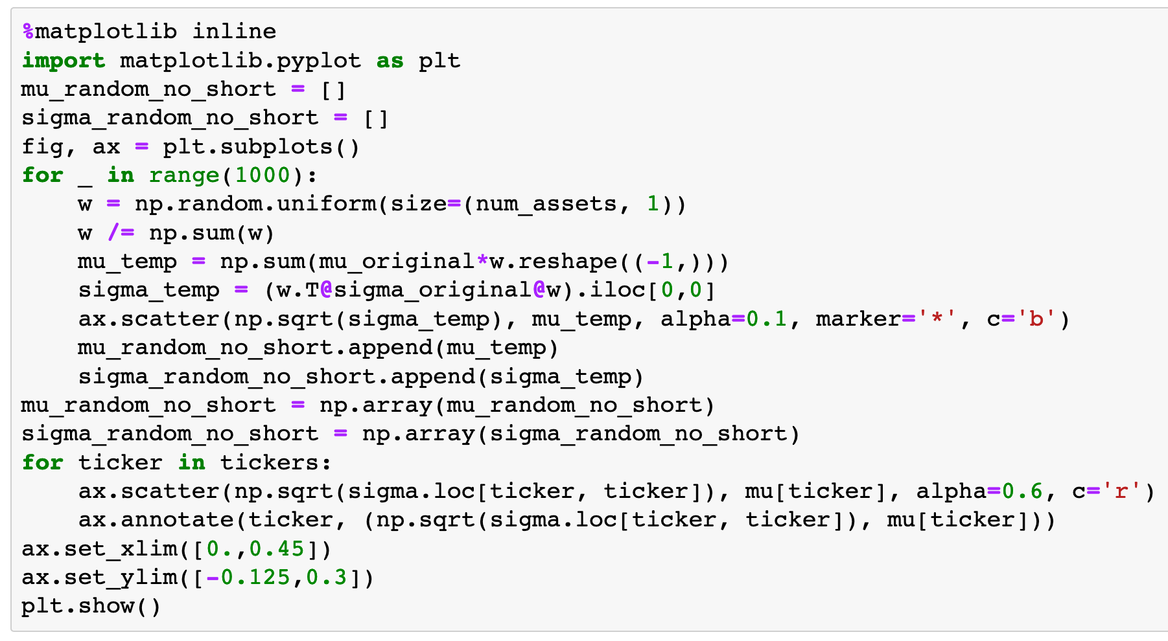

Slide 15
No Short Positions

Slide 16
No Short Positions
Portfolio

Slide 20
(5,)

Slide 21
(5,)
(5,)

Slide 22
Numpy
Array

Slide 23
Pandas
Series
Numpy
Array

Slide 24
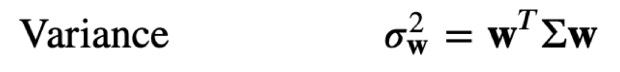

Slide 28
(5,1)

Slide 29
(5,5)
(5,1)

Slide 30
(1,5)
(5,5)
(5,1)

Slide 31
Numpy Array

Slide 32
Numpy Array
Pandas DataFrame

Slide 33
Numpy Array
Pandas DataFrame
Numpy Array

Slide 34
Risk

Slide 35
Risk
Return

Slide 36
Risk
Return
Scatter Plot

Slide 37
Record Risk and Return

Slide 38
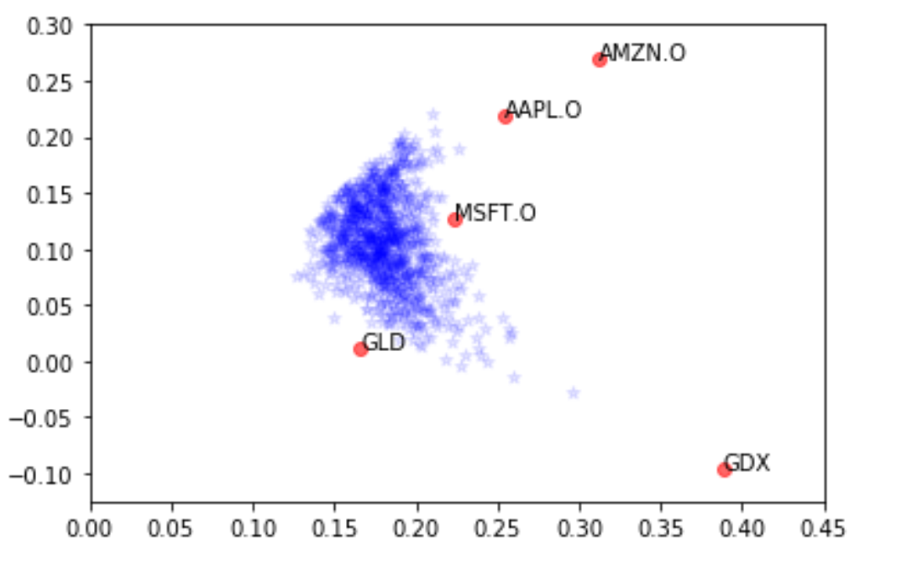

Slide 39
Random Portfolios
(Short Positions)

Slide 40
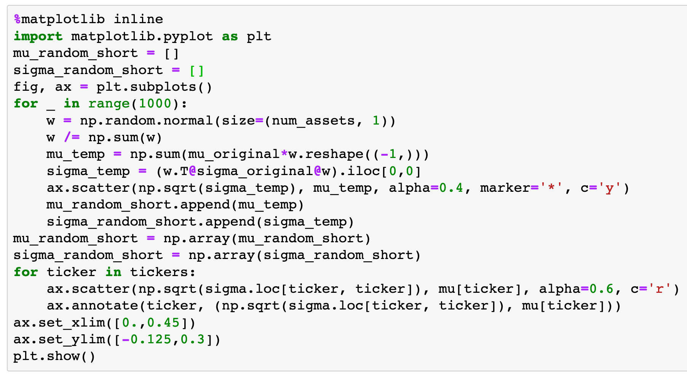

Slide 41
Short Positions Allowed

Slide 42
Short Positions Allowed
Portfolio

Slide 44
Now
Let’s Play with Code

